Slide 1
Chapter 1
Databases and Database Users
Basic Definitions
Example of a Database
Main Characteristic of Database Technology
Classes of Database Users
Additional Characteristics of Database Technology
When Not to Use a DBMS

Slide 2
1. Basic Definitions
Database: A collection of related data
Data: Known facts that can be recorded and have an implicit meaning
Mini-world: some part of the real world about which data is stored in a database.For example, student grades and transcripts at a university.
(醫院有醫院在用的data大學有大學的data)
Database Management System(DBMS): A software package to facilitate the creation and maintenance of a computerized database
Database System: The DBMS software together with the data itself

Slide 3
2. Example of a Database
Mini-world for the example:Part of a UNIVERSITY environment
Some mini-world entities:
  STUDENTs
  COURSEs
  SECTIONs(同一門course不同班)
  (academic) DEPARTMENTs
  INSTRUCTORs
Some mini-world relationships:
  SECTIONs are of specific COURSEs

Slide 4
(cont.)
  STUDENTs take SECTIONs
  COURSEs have prerequisite COURSEs
  INSTRUCTORs teach SECTIONs
  COURSEs are offered by DEPARTMENTs
  STUDENTs major in DEPARTMENTs

Slide 5
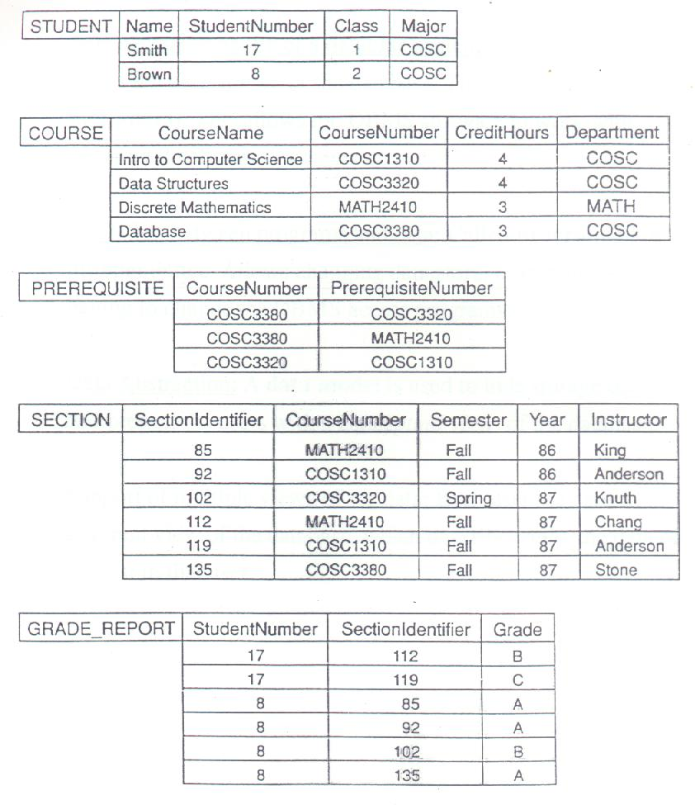
Figure 1.2

Slide 6
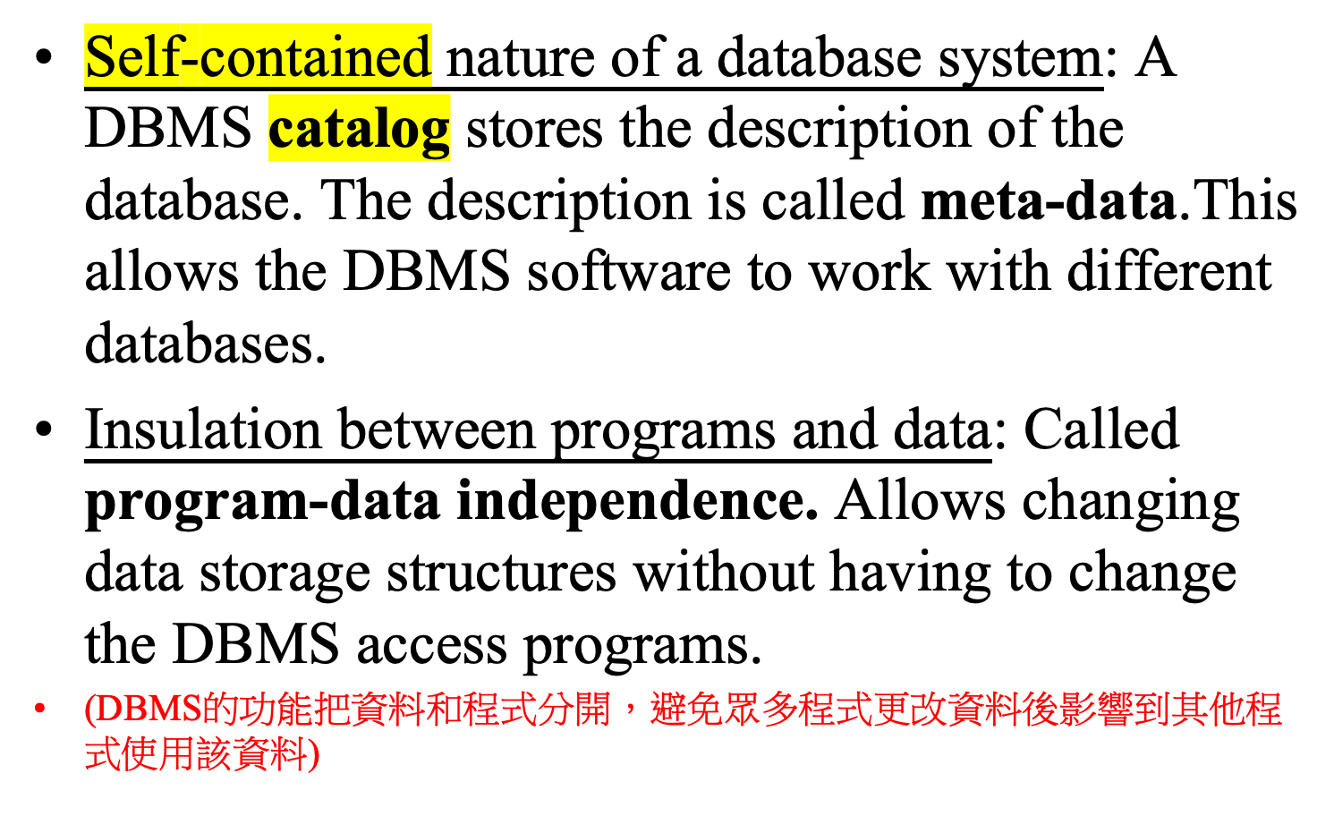
3. Main Characteristics of Database Technology
不需透過額外的軟體來管理該資料庫系統，僅用系統本身即可管理
目錄
目錄內容

Slide 7
(cont.)
Data Abstraction(看到大致上資料形式ex:學生名字+成績+科系…): A data model(表達資料的方式 ex:表格、tree、物件的方式) is used to hide storage details and present the users with a conceptual view of the database
Support of multiple views of the data: Each user may see a different view of the database, which describes only the data of interest to that user.

Slide 8
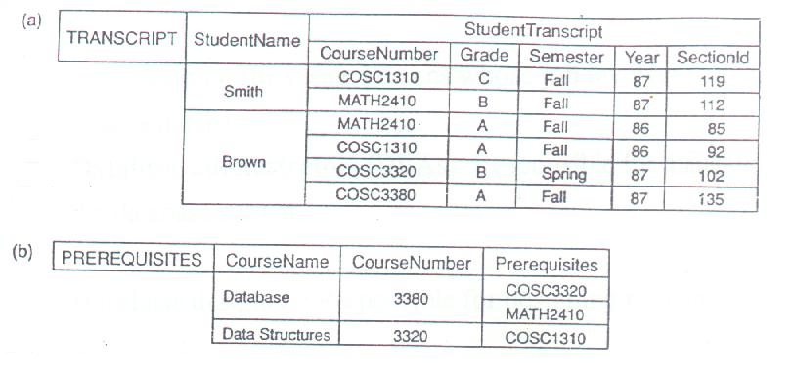
Figure 1.4

Slide 9
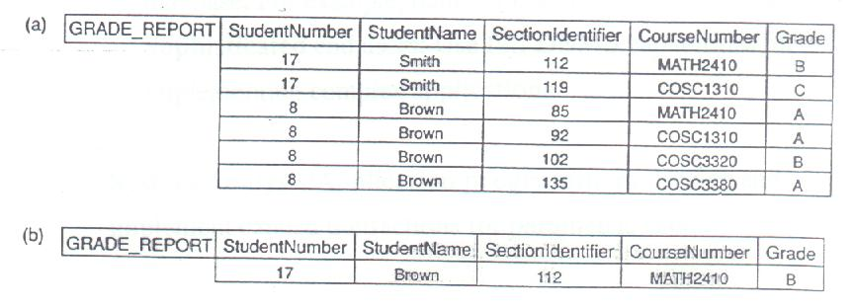
Figure 1.5

Slide 10
4. Classes of Database Users
(A) Workers on the scene: Persons whose job involves daily use of a large database
Database adminstrators(DBAs): Responsible for managing the database system
Database designers: Responsible for designing the database
End Users: The persons that use the database for querying, updating, generating reports,etc.
  Casual end users: Occasional users
  Parametric(or naïve) end users: They use pre-programmed canned transactions to interact continuously with the database. For example, bank tellers or reservation clerks

Slide 11
(cont.)
  Sophisticated end users: Use full DBMS capabilities for implementing complex applications.
System Analysts/Application programmers: Design and implement canned transactions for parametric users
(B) Workers behind the scene: Persons whose job involves design, development, operation, and maintenance of the DBMS software and system environment.
DBMS designers and implementers: Design and implement the DBMS software package itself.

Slide 12
(cont.)
Tool developers: Design and implement tools that facilitate the use of the DBMS software. Tools include design tools, performance tools, special interfaces, etc.
Operators and maintenance personnel: Work on running and maintaining the hardware and software environment for the database system.

Slide 13
5. Additional Characteristics of Database Technology
Controlling redundancy in data storage and in development and maintenance efforts
Sharing of data among multiple users
Restricting unauthorized access to data
Providing multiple interfaces to different classes of users
Representing complex relationships among data
Enforcing integrity constraints on the database
Providing backup and recovery services

Slide 14
(cont.)
Potential for enforcing standards
Flexibility to change data structures
Reduced application development time
Availability of up-to-date information
Economies of scale

Slide 15
6. When not to use a DBMS
Main costs of using a DBMS:
  High initial investment and possible need for additional hardware
  Overhead for providing generality, security, recovery, integrity, and concurrency control
When a DBMS may be unnecessary:
  If the database and applications are simple, well defined and not expected to change
  If there are stringent real-time requirements that may not be met because of DBMS overhead
  If access to data by multiple users is not required

Slide 16
Chapter 2
DBMS Concepts and Architecture
Data Models
Schemas versus Instances
Three-Schema Architecture
Data Independence
DBMS Languages
DBMS Interfaces
DBMS Component Modules
Database System Utilities
Classification of DBMSs

Slide 17
1. Data Models
Data Model: A set of concepts to describe the structure of a database, and certain constraints that the database should obey.
Data Model Operations: Operations for specifying database retrievals and updates by referring to the concepts of the data model
Categories of data models:
  Conceptual (high-level, semantic) data models: Provide concepts that are close to the way many user perceive data.(Also called entity-based or object-based data models.) (位於上層，給人看此資料中有哪些欄位)

Slide 18
(cont.)
  Physical(low-level,internal) data models: Provide concepts that describe details of how data is stored in the computer.(位於下層，在硬碟中資料存放的方式)
  Implementation(record-oriented) data models: Provide concepts that fall between the above two, balancing user views with some computer storage details.(位於中間，提供Physical 和 conceptual 之間的轉換使用)
  (ex: conceptual 的資料轉換成表格(implementation model -> 再轉換成存放在硬碟的方式(Physical ))

Slide 19
2. Schemas versus Instances
綱目/資料的架構
Database Schema: The description of a database. Includes descriptions of the database structure and the constraints that should hold on the database.
Schema Diagram: A diagrammatic display of (some aspects of) a database schema.
Database Instance: The actual data stored in a database at a particular moment in time. Also called database state (or occurrence).
The database schema changes very infrequently. The database state changes every time the database is updated. Schema is also called intension, whereas state is called extension.
資料以圖的方式呈現
資料在某一時間點的資料

Slide 20
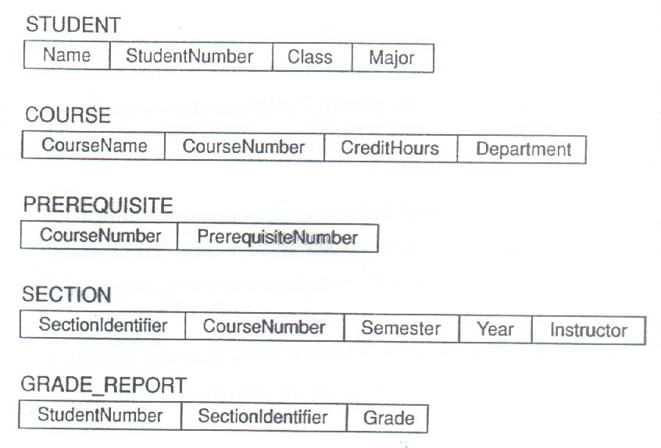
Figure 2.1
schema

Slide 21
3. Three-Schema Architecture
Proposed to support DBMS characteristics of:
  Program-data independence
  Support of multiple views of the data.
Defines DBMS schemas at three levels:
  Internal schema at the internal level to describe data storage structures and access paths. Typically uses a physical data model.
  Conceptual schema at the conceptual level to describe the structure and constraints for the whole database. Uses a conceptual or an implementation data model.

Slide 22
(cont.)
  External schemas at the external level to describe the various user views. Usually uses the same data model as the conceptual level.
Mappings among schema levels are also needed. Programs refer to an external schema, and are mapped by the DBMS to the internal schema for execution.

Slide 23
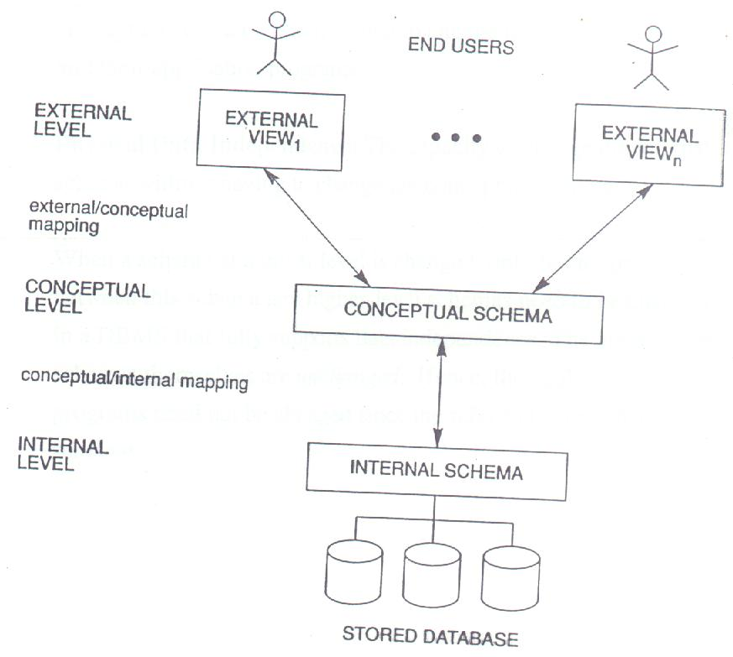
Figure 2.2
使用者或管理員所能看到資料庫的部分
也能以Schema的方式呈現
使用者包含管理員的Schema整合在一起
存放在硬碟內部的schema(資料架構)

Slide 24
4. Data Independence
Logical Data Independence: The capacity to change the conceptual schema without having to change the external schemas and their application programs.
Physical Data Independence: The capacity to change the internal schema without having to change the conceptual schema.
When a schema at a lower level is changed, only the mappings between this schema and higher-level schemas need to be changed in a DBMS that fully supports data independence.The higher-level schemas themselves are unchanged. Hence, the application programs need not be changed since the refer to the external schemas.

Slide 25
5. DBMS Languages
專門給程式用來描述所要取得的資料
Data Definition Language(DDL):
Used by the DBA and database designers to specify the conceptual schema of a database.In many DBMSs, the DDL is also used to define internal and external schemas (views). In some DBMSs, separate storage definition language (SDL) and view definition language (VDL) are used to define internal and external schemas.
Data Manipulation Language(DML):
used to specify database retrievals and updates
描述一個表格的各個欄位
描述要表格中哪一個資料

Slide 26
(cont.)
  DML commands (data sublanguage) can be embedded in a general-purpose programming language(host language), such as COBOL, PL/1 or PASCAL.
  (以一個應用程式透過使用者操作後轉換成DML指令傳送給DBMS)
  Alternatively, stand-alone DML commands can be applied directly (query language)
  (會運用DBMS的語言直接操作的使用者)

Slide 27
Types of DML
按照指令順序一條條往下跑
Procedural DML: Also called record-at-a-time or low-level DML. Must be embedded in a programming language. Searches for and retrieves individual database records, and uses looping and other constructs of the host programming language to retrieve multiple records.
Declarative or non-procedural DML: Also called set-at-a-time or high-level DML. Can be used as a stand-alone query language or can be embedded in a programming language. Searches for and retrieves information from multiple related database records in a single command.
用來表達規則、和指令的順序無關

Slide 28
6. DBMS Interfaces
Stand-alone query language interfaces
Programmer interfaces for embedding DML in programming languages:
  Pre-compiler Approach
  Procedure(Subroutine) Call Approach
User-friendly interfaces:
  Menu-based
  Graphics-based
  Forms-based
  Natural language
  Combinations of the above

Slide 29
(cont.)
Parametric interfaces using function keys
Report generation languages
Interfaces for the DBA(資料管理員):
  Creating accounts, granting authorizations
  Setting system parameters
  Changing schemas or access path

Slide 30

Figure 2.3

Slide 31
8. Database System Utilities
To perform certain functions such as:
  Loading data stored in files into a database
  Backing up the database periodically on tape
  Reorganizing database file structures
  Report generation utilities
  Performance monitoring utilities
  Other functions, such as sorting,user monitoring, data compression,etc.
Data dictionary(目錄) utility:
  Used to store schema descriptions and other information such as design decisions, application program descriptions,user information,usage standards,etc.

Slide 32
(cont.)
  Active data dictionary is accessed by DBMS software and users/DBA
  Passive data dictionary is accessed by users/DBA only.

Slide 33
9. Classification of DBMSs
Based on the data model used:
  Traditional: Relational, Network, Hierarchical
  Emerging: Object-oriented, Semantic, Entity-Relationship, other
Other classifications:
  Single-user (typically used with micro-computers) vs. multi-user (most DBMSs)
  Centralized (uses a single computer) vs. distributed (uses multiple computers)
  Cost of DBMS software
  Types of access paths used.

Slide 34
Chapter 3
Data Modeling Using the Entity-Relationship(ER)(實體關係) Data Model
Database Design Process
Example Database Application(COMPANY)
ER Model Concepts
  Entities and Attributes
  Entity Types, Value Sets, and Key Attributes
  Relationships and Relationship Types
  Structural Constraints and Roles
  Weak Entity Types
ER Diagrams Notation
Relationships of Higher Degree

Slide 35
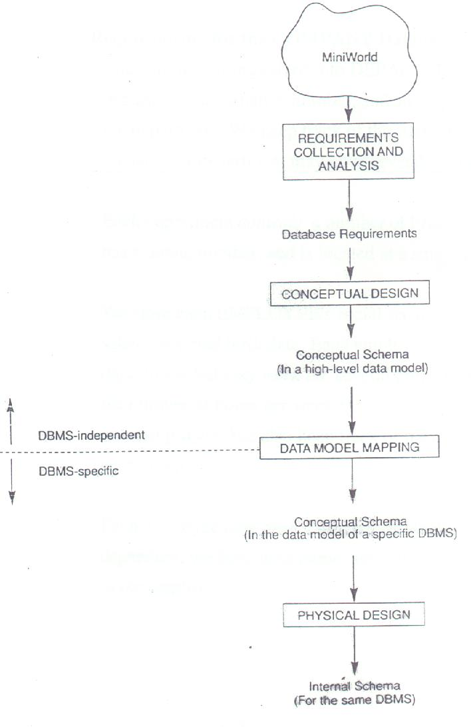
Figure 3.1
產生Conceptual schema

Slide 36
2. Example COMPANY Database
Requirements for the COMPANY Database:
  The company is organized into DEPARTMENTs. Each department has a name, number and an employee who manages the department. We keep track of the start date of the department manager. A department may have several locations.
  Each department controls a number of PROJECTs. Each project has a name, number, and is located at a single location

Slide 37
(cont.)
We store each EMPLOYEE’s social security number, address, salary, sex, and birth date. Each employee works for one department but may work on several projects.We keep track of the number of hours per week that an employee currently works on each project. We also keep track of the direct supervisor of each employee.
Each employee may have a number of DEPENDENTs. For each dependent, we keep their name, sex, birth date, and relationship to the employee.

Slide 38
3. ER Model Concepts
3.1 Entities and Attributes
Entities(實體) are specific objects or things in the mini-world that are represented in the database; for example the EMPLOYEE John Smith, the Research DEPARTMENT, the ProductX PROJECT
Attributes(形容實體的特徵) are properties used to describe an entity for example an EMPLOYEE entity may have a NAME, SSN, Address, Sex, BirthDate.
Ex: an employee (Entities) has a name(attribute)

Slide 39
(cont.)
A specific entity will have a value for each of its attributes; for example a specific employee entity may have Name = ‘John Smith’, Sex = ‘M’, BirthDate = ’09-JAN-55’
Types of Attributes:
  Simple(單值: ex: 身分證字號只有一項): Each entity has a single atomic value for the attribute; for example SSN or Sex
  Composite(組合性的：ex:地址有街、路、巷…): The attribute may be composed of several components; for example Address(Apt#, House#, Street, City, State, ZipCode, Country) or Name(FirstName, MiddleName, LastName). Composition may form a hierarchy where some components are themselves composite.
需看使用者該attribute 是否得為Composite 或是Simple
Ex: 使用者希望把名字拆成姓和名，此時就會作為Composite attribute
而非把姓名和成一個值成為simple attribute

Slide 40
(cont.)
  Multi-valued: An entity may have multiple values for that attribute; for example Color of a CAR or PreviousDegrees of a STUDENT. Denoted as {Color} or {PreviousDegrees}
In general, composite and multi-valued attributes may be nested arbitrarily to any number of levels although this is rare. For example, PreviousDegrees of a STUDENT is a composite multi-valued attribute denoted by {PreviousDegrees(College, Year, Degree, Field)}

Slide 41
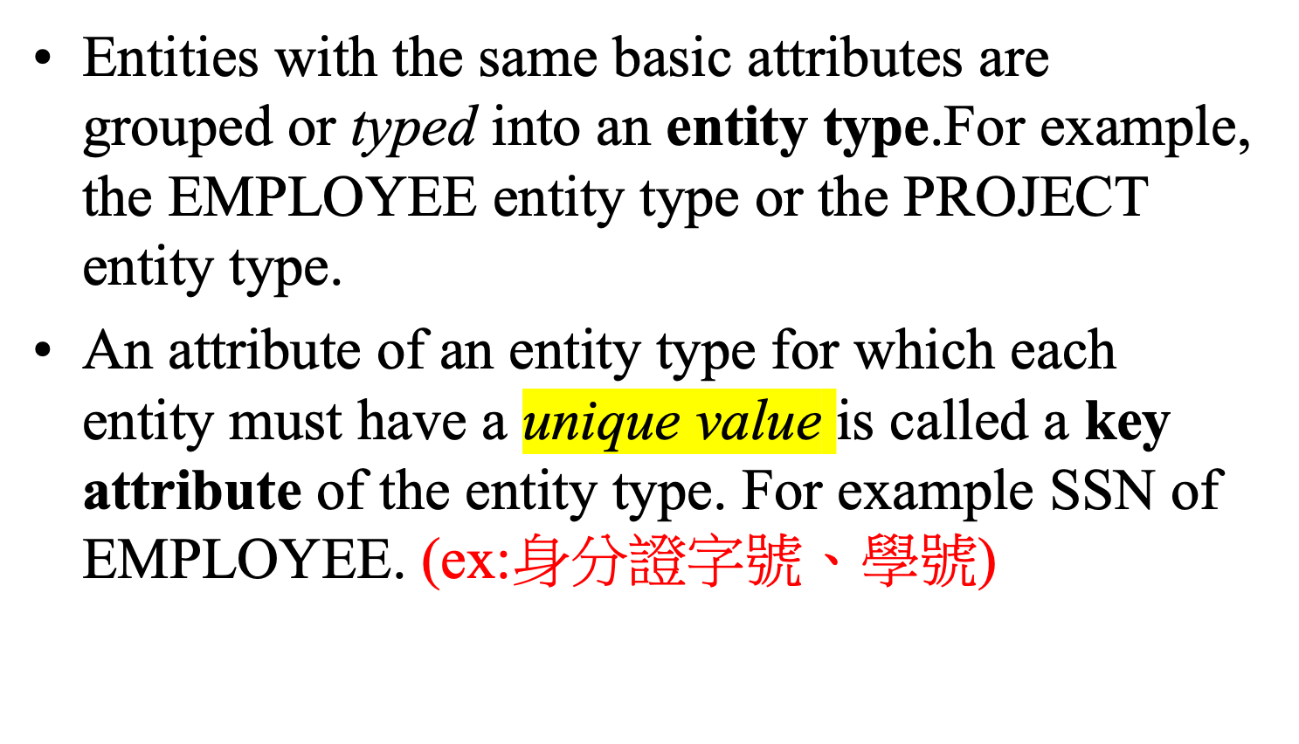
3.2 Entity Types and key Attributes

Slide 42
(cont.)
A key attribute may be composite. For example, VehicleRegistrationNumber is a key of the CAR entity type with components(Number, State)
An entity type may have more than one key. For example, the CAR entity type may have two keys: VehicleIdentificationNumber and VehicleRegistrationNumber(Number, State)

Slide 43
3.3 Relationships and Relationship Types
A relationship relates two or more distinct entities with a specific meaning; for example, EMPLOYEE John Smith works on the ProductX PROJECT or EMPLOYEE Franklin Wong manages the Research DEPARTMENT.
Relationships of the same type are grouped or typed into a relationship type. For example, the WORKS_ON relationship type in which EMPLOYEEs and PROJECTs participate, or the MANAGES relationship type in which EMPLOYEEs and DEPARTMENTs participate.

Slide 44
(cont.)
The degree of a relationship type is the number of participating entity types. Both MANAGES and WORKS_ON are binary relationships.
More than one relationship type can exist with the same participating entity types; for example, MANAGES and WORKS_FOR are distinct relationships between EMPLOYEE and DEPARTMENT participate.

Slide 45
3.4 Structural Constraints and Roles
A relationship can relate two entities of the same entity type; for example, a SUPERVISION relationship type relates one EMPLOYEE (in the role of supervisee) to another EMPLOYEE(in the role of supervisor). This is called a recursive relationship type.
A relationship type can have attributes; for example, HoursPerWeek of WORKS_ON; its value for each relationship instance describes the number of hours per week that an EMPLOYEE works on a PROJECT.

Slide 46
(cont.)
Structural constraints on relationships:
Cardinality ratio (of a binary relationship): 1:1, 1:N, N:1, or M:N
Participation constraint(on each participating entity type): total (called existence dependency) or partial.

Slide 47
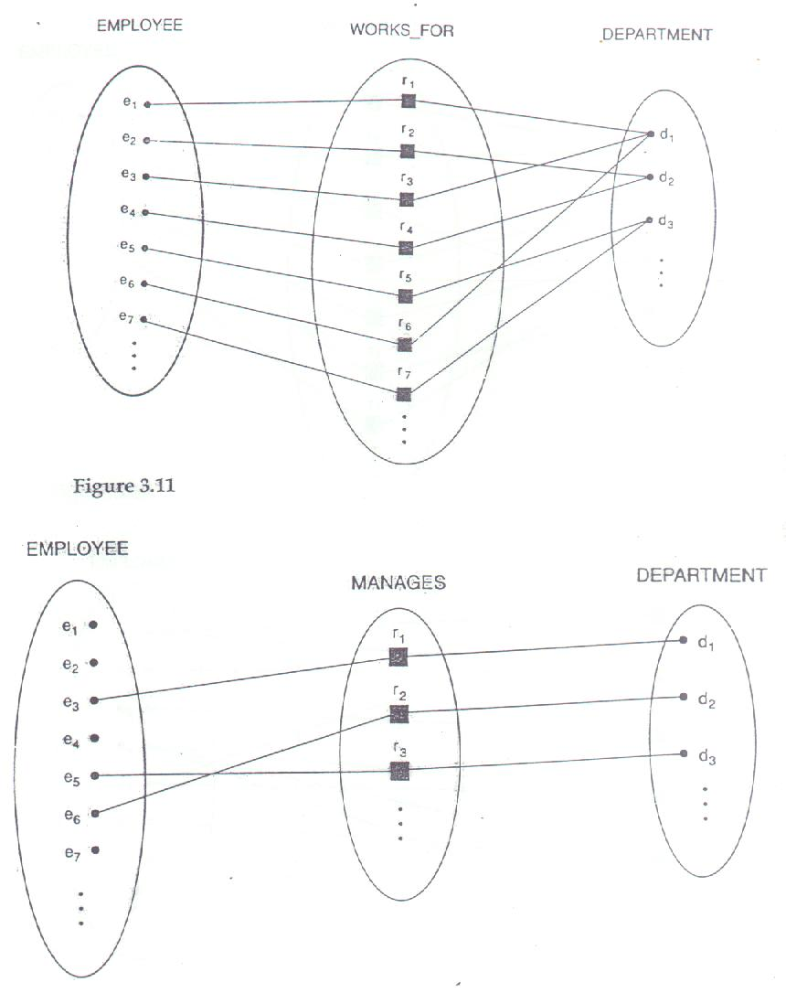
Figure 3.8
Figure 3.11

Slide 48
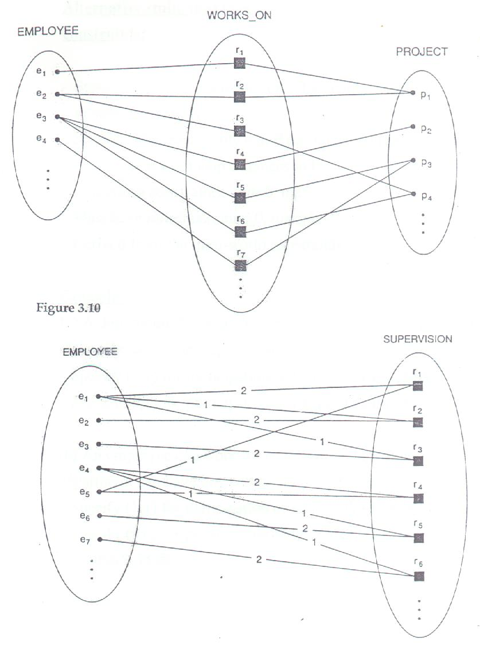
Figure 3.12
Figure 3.10

Slide 49
(cont.)
Alternative(min, max) notation for relationship structural constraints:
  Specified on each participation of an entity type E in a relationship type R.
  Specifies that each entity e in E participates in at least min and at most max relationship instances in R.
  Default(no constraint): min = 0, max = n
  Must have min≤max, min≥0, max≥1
  Derived from the mini-world constraints

Slide 50
(cont.)
Examples:
  (a) A department has exactly one manager and an employee can manage at most one department.
    Specify(1,1) for participation of EMPLOYEE in MANAGES
    Specify(0,1) for participation of EMPLOYEE in MANAGES
  (b) An employee can work for exactly one department but a department can have any number of employees
    Specify(1,1) for participation of EMPLOYEE in WORKS_FOR
    Specify(0,n) for participation of DEPARTMENT in WORKS_FOR

Slide 51
3.4 Weak Entity Types
An entity type that does not have a key attribute
A weak entity type must participate in an identifying relationship type with an owner or identifying entity type
Entities are identified by the combination of:
  A partial key of the weak entity type
  The particular entity they are related to in the identifying entity type
Example:

Slide 52
(cont.)
Suppose that a DEPARTMENT entity is identified by the dependent’s first name and birthdate, and the specific EMPLOYEE that the dependent is related to. DEPENDENT is a weak entity type with EMPLOYEE as its identifying entity type via the identifying relationship type DEPENDENT_OF

Slide 53
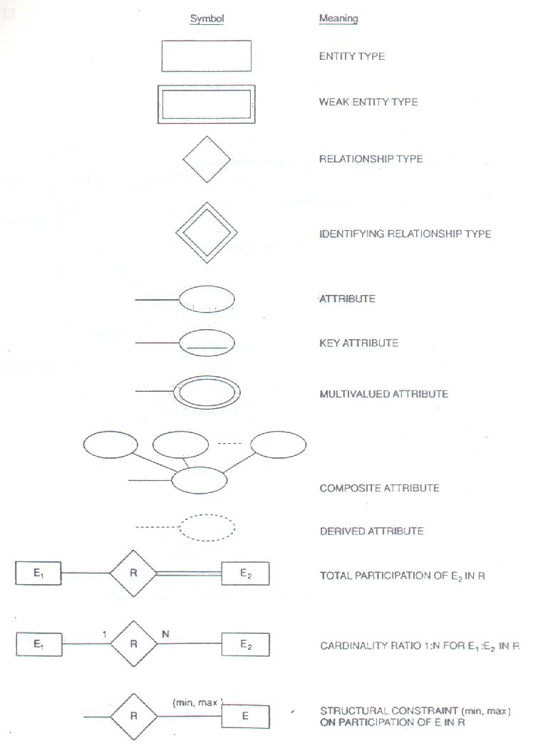
Figure 3.15

Slide 54
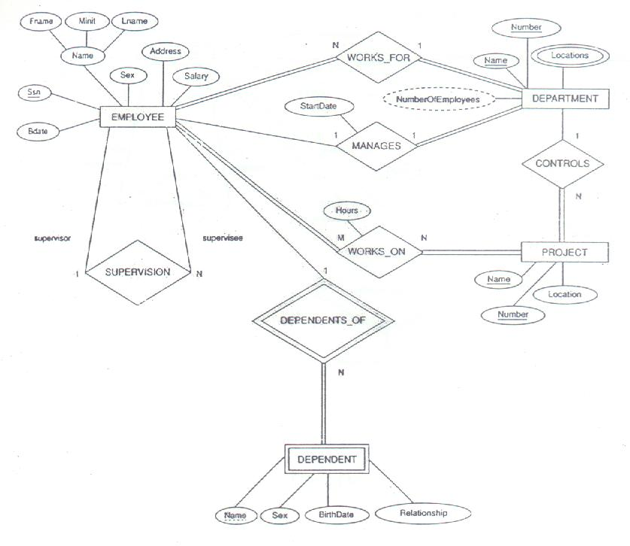
Figure 3.13

Slide 55
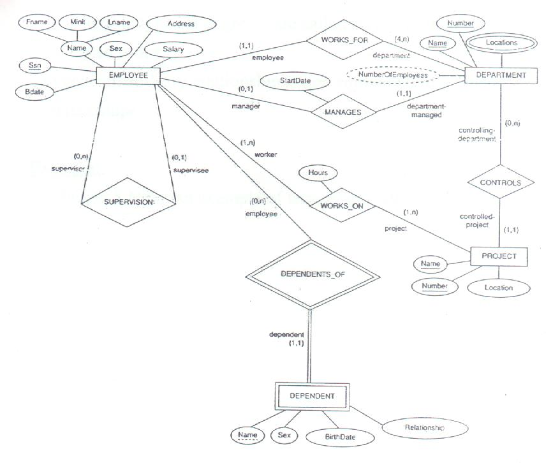
Figure 3.14

Slide 56
5. Relationships of Higher Degree
Relationship types of degree 2 are called binary
Relationship types of degree 3 are called ternary and of degree n are called n-ary
In general, an n-ary relationship is not equivalent to n binary relationships
Example:
  See Figure 3.16 for an example of ternary relationship

